Slide 1
ANL201 – Study Units
Time frame and Deliverables
Study Unit | Topic | Date (2022) | Quiz | Deadlines
1 | Business Performance Management Balanced Scorecard Strategy Map | 05th Feb | Pre-Course Quiz 01* | 24th Jan – 4th Feb
2 | All about Data | 10th Feb | Pre-Class Quiz 01* | 7th Feb – 14th Feb
 |  |  | Tutor Marked Assignment | 16th Feb (by 2355 hrs)
3 | Theory/ Foundation to Visualization | 17th Feb | Pre-Class Quiz 02* - | 21st Feb – 28th Mar
4 | Basic Visualization | 24th Feb |  | -
5 | Advanced Visualization | 3rd Mar | Group Based Assignment | 2nd Mar (by 2355 hrs)
6 | Business Performance Dashboard | 10th Mar | End of Course Assessment | 17th Mar (by noon)
*All quizzes have a 12-NOON deadline. No extensions!

Slide 2
Learning Objectives of ANL201
By the end of this Course
Understand concepts of Business Performance, Measurement, Balanced Scorecard Model and Data Visualization
Compare stages of Data Visualization Process
Data Visualization Components
Design Principles of a Business Performance Dashboard
Appropriateness of Data Visualization techniques based on available data
Appropriates of Business Performance Measure against Business Strategy of Organization
Required Textbooks:
Yau, N,.(2013). Data Points: Visualization that Means Something
Murray, D. G. (2013). Tableau Your Data

Slide 3
Visualisation for Business ANL 201
Advanced Data Visualisation Techniques Study Unit 5
January 2022

Slide 4
Visualisation of Spatial Data

Slide 5
Visualisation of Spatial Data
Recall: We last discussed categorical and time-series data
Best practices for visualising spatial data (1/2)
The most common way to visualise spatial data is with maps that place values within a geographic coordinate. We can visualise the geographic coordinate of a location by mapping the latitude and longitude coordinates to two-dimensional space, and draw a point on the space.
When the density of individual locations across a region is more informative than the overlapping points on a map, we may want to colour code the region based on the density scale, or use lines to show data continuously over geography.

Slide 6
Visualisation of Spatial Data
Best practices for visualising spatial data (2/2)
We can also size the regions by the data and ignore the physical area, so that the regions with high density data will appear bigger than the regions with low density data
If we want to explore relationships between entities, we can plot each entity on a map, and draw lines to connect each with the others they are associated with
A practical tip - there is a “local” context component to spatial data mapping. For example, would you expect someone who has never been to Singapore to know where Clementi is on a map, unless its explicitly pointed out?
Maps require that you have some background knowledge of the locale; therefore, if you want to use maps, know your audience!

Slide 7
Visualisation of Spatial Data
Visualising spatial data
Map
Mapping Point-to-Point Details on Map

Slide 8
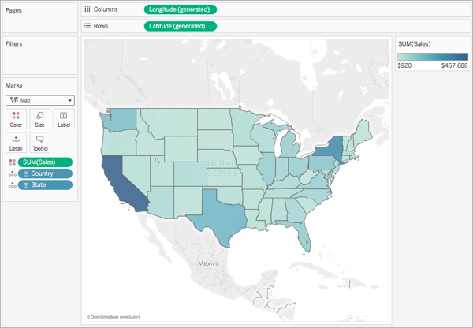
Visualisation of Spatial Data
Visualising spatial data — map
Assign “Geographic Role” to fields that are Geographic data.
Double click the “Region” field under Dimension of the Data window. The Tableau will automatically add Longitude and Latitude coordinates to the columns and rows shelves. The “Region” field is automatically placed on the Level of Detail shelf.
Drag the “Postal Code” field to the Level of Detail shelf to specify more details.
https://help.tableau.com/current/pro/desktop/en-us/maps_howto_simple.htm

Slide 9
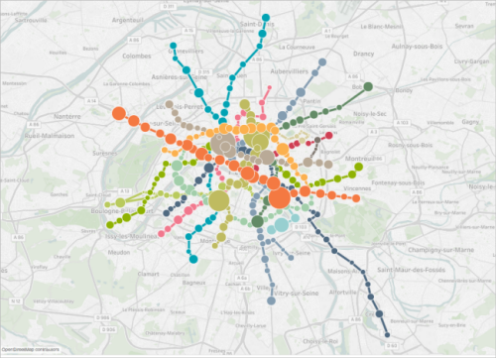
Visualisation of Spatial Data
Visualising spatial data — point-to-point details on map
Used to see linkages between data points e.g., point of origin of goods to where customers are based to answer questions related to “zone of influence”. Could be used to map transportation or logistic routes as well.
Note that it can be a bit overwhelming; sometimes in visualization, less is more!
https://help.tableau.com/current/pro/desktop/en-us/maps_howto_origin_destination.htm

Slide 10
Visualisation of Multi Variable Data

Slide 11
Visualisation of Multi Variable Data
Best practices for visualising multi variable data
To visualise multi-variable data, we can fit all data onto a screen and display the relationships amongst variables or trends in each variables
We can use scatterplots to visualise the relationships amongst variables
However, if the relationships amongst variables are not so straightforward, we should consider using multiple views through more straightforward charts
Correlation → how one variable’s value tends to change in a certain way as the other variable’s value changes
Causation → Extent of how one variable will impact another
Easier to prove correlation than causation
Correlation DOES NOT IMPLY Causation

Slide 12
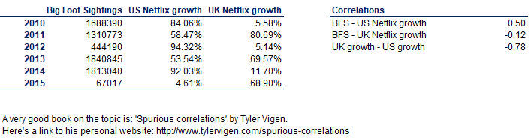
Visualisation of Multi Variable Data
Correlation vs Causation – An (absurd) example
Correlation is in the range of +/- 1, the larger the absolute number, the stronger the relationship between the 2 variables.
In the above example, I would say there is a (fairly) strong correlation between Big Foot Sightings and Netflix growth in the US. But would it be logical if I said big foot sightings cause the growth in US Netflix users?

Slide 13
Visualisation of Multi Variable Data
Visualising multi variable data
Scatterplot
Circle View
Side-by-Side Circle Plots

Slide 14
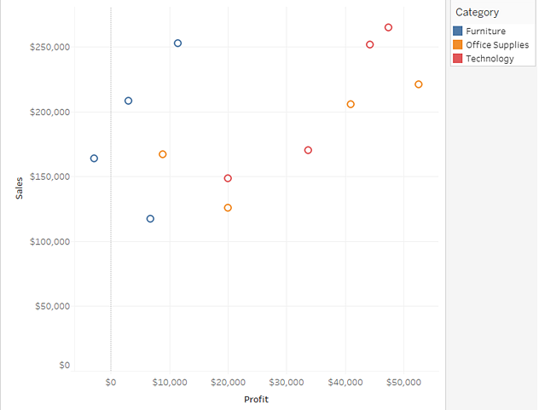
Visualisation of Multi Variable Data
Visualising multi variable data — scatterplot
Uses Cartesian coordinates to display values for typically two variables for a set of data.
Dots not only report the values of individual data points, but also patterns when data are taken together i.e., how closely points are clustered together. Also useful to identify gaps in data.
Identification of correlational relationships are common with scatter plots. Variable on horizontal axis denoted an independent variable, and the variable on the vertical axis the dependent variable. Relationships between variables can be described in many ways: positive or negative, strong or weak, linear or nonlinear.
Overplotting
Can be difficult to tell how densely-packed data points are when many of them are in a small area.
Subset/Averaging
Optics - Adding transparency or reducing point size
https://help.tableau.com/current/pro/desktop/en-us/buildexamples_scatter.htm
Notes:
A scatter plot is a type of plot or mathematical diagram using Cartesian coordinates to display values for typically two variables for a set of data. If the points are coded, one additional variable can be displayed.
Scatter plots’ primary uses are to observe and show relationships between two numeric variables. The dots in a scatter plot not only report the values of individual data points, but also patterns when the data are taken as a whole.
Identification of correlational relationships are common with scatter plots. In these cases, we want to know, if we were given a particular horizontal value, what a good prediction would be for the vertical value. You will often see the variable on the horizontal axis denoted an independent variable, and the variable on the vertical axis the dependent variable. Relationships between variables can be described in many ways: positive or negative, strong or weak, linear or nonlinear.
A scatter plot can also be useful for identifying other patterns in data. We can divide data points into groups based on how closely sets of points cluster together. Scatter plots can also show if there are any unexpected gaps in the data and if there are any outlier points. This can be useful if we want to segment the data into different parts, like in the development of user personas.
Overplotting
When we have lots of data points to plot, this can run into the issue of overplotting. Overplotting is the case where data points overlap to a degree where we have difficulty seeing relationships between points and variables. It can be difficult to tell how densely-packed data points are when many of them are in a small area. There are a few common ways to alleviate this issue. One alternative is to sample only a subset of data points: a random selection of points should still give the general idea of the patterns in the full data. We can also change the form of the dots, adding transparency to allow for overlaps to be visible, or reducing point size so that fewer overlaps occur. As a third option, we might even choose a different chart type like the heatmap, where color indicates the number of points in each bin. Heatmaps in this use case are also known as 2-d histograms.
Interpreting correlations as causation
Add a trend line
Categorical third variable
Numeric third variable

Slide 15
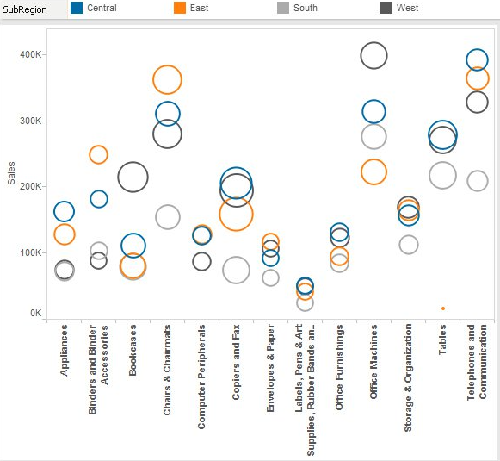
Visualisation of Multi Variable Data
Visualising multi variable data — circle view
https://www.interworks.com/sites/default/files/blog/TECTCircle2.jpg

Slide 16
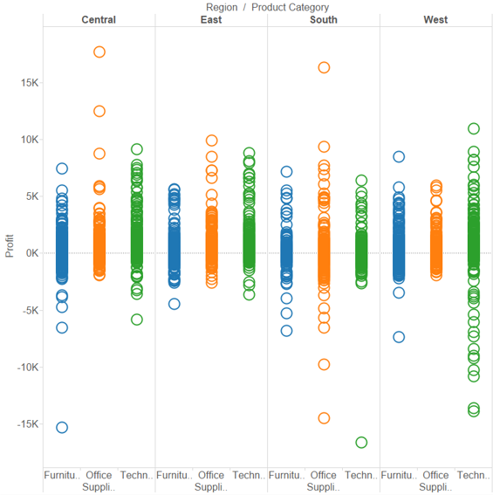
Visualisation of Multi Variable Data
Visualising multi variable data — side-by-side circle plot
http://www.theinformationlab.co.uk/wp-content/uploads/2015/03/Side-by-side-Circle-view2.png

Slide 17

Discussion
What type of chart will you recommend for the scenarios listed?
(a) The Customer Service Director of a network service provider is interested to know where majority of their customers are residing so that he is able to plan the location of the new service centre.
(b) The Sales Director of a mobile phone manufacturer is interested to compare the sales performance of a new mobile model that had just been launched in the various regions.
(c) The Product Director of a mobile phone manufacturer is interested to compare the sales performance of a new mobile model that had just been launched with other mobile models of the company in the various regions.
Notes:
Map
Circle View
Side-by-Side Circle Plot Chart

Slide 18
Discussion
What type of chart will you recommend for the scenarios listed?
(a) The Customer Service Director of a network service provider is interested to know where majority of their customers are residing so that he is able to plan the location of the new service centre.
Map
(b) The Sales Director of a mobile phone manufacturer is interested to compare the sales performance of a new mobile model that had just been launched in the various regions.
Circle View
(c) The Product Director of a mobile phone manufacturer is interested to compare the sales performance of a new mobile model that had just been launched with other mobile models of the company in the various regions.
Side-by-Side Circle Plot Chart
Notes:
Map
Circle View
Side-by-Side Circle Plot Chart

Slide 19
Visualisation of Data Distributions
(15 min break)

Slide 20
Visualisation of Data Distributions
Best practices for visualising data distributions
We can visualise the distribution of data at different granularities with bullet charts, bubble charts, and histograms
For single-variable distributions, using a histogram will enable us to see where the data is clustered and any outliers, by keeping track of where the outliers sit on the vertical axis
For multi-variable distributions, sometimes values come as pairs, so it makes more sense to visualise both values at the same time

Slide 21
Visualisation of Data Distributions
Visualising data distributions
Bullet Chart
Bubble Chart
Histogram
Box Plot
Pareto Chart

Slide 22
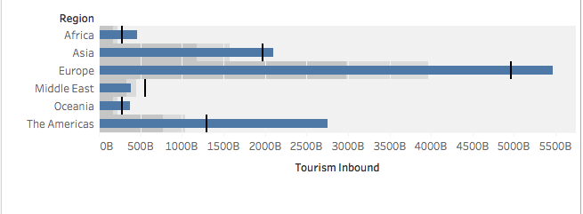
Visualisation of Data Distributions
Visualising data distributions — bullet chart
Reference line and reference distributions
https://help.tableau.com/current/pro/desktop/en-us/qs_bullet_graphs.htm

Slide 23
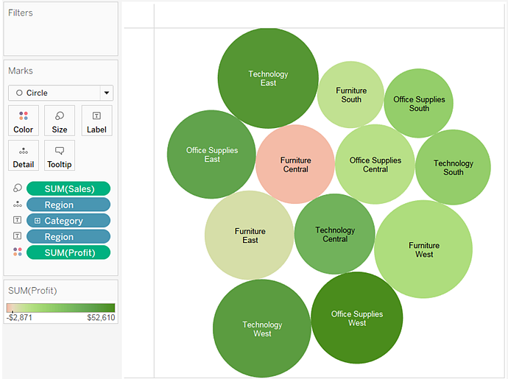
Visualisation of Data Distributions
Visualising data distributions — bubble chart
Use packed bubble charts to display data in a cluster of circles.
Dimensions define the individual bubbles, and measures define the size and color of the individual circles.
Note that its not very useful for precise comparisons
https://help.tableau.com/current/pro/desktop/en-us/buildexamples_bubbles.htm
Notes:
Use packed bubble charts to display data in a cluster of circles. Dimensions define the individual bubbles, and measures define the size and color of the individual circles.

Slide 24
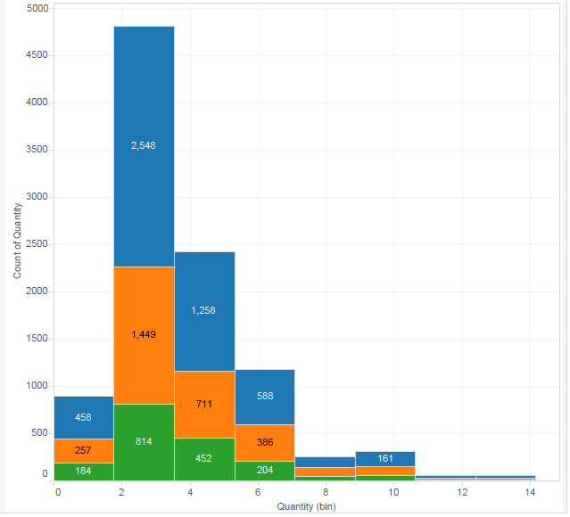

Visualisation of Data Distributions
Visualising data distributions — histogram
Histograms are used to show distributions of variables while bar charts are used to compare variables.
Histograms plot quantitative data with ranges of the data grouped into bins or intervals while bar charts plot categorical data.
https://help.tableau.com/current/pro/desktop/en-us/buildexamples_histogram.htm
Notes:
Histograms are used to show distributions of variables while bar charts are used to compare variables. Histograms plot quantitative data with ranges of the data grouped into bins or intervals while bar charts plot categorical data.

Slide 25
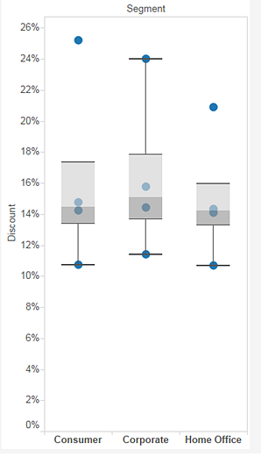
Visualisation of Data Distributions
Visualising data distributions — box plot
Whiskers = 1.5*interquartile range (IQR)
IQR = 1.5*(P75-P25)
Upper Quartile (P75)
Box = Middle two quartiles of data's distribution (P25 to P75)
Median (P50)
Lower Quartile (P25)
Extreme points = Min/Max
https://help.tableau.com/current/pro/desktop/en-us/buildexamples_boxplot.htm

Slide 26
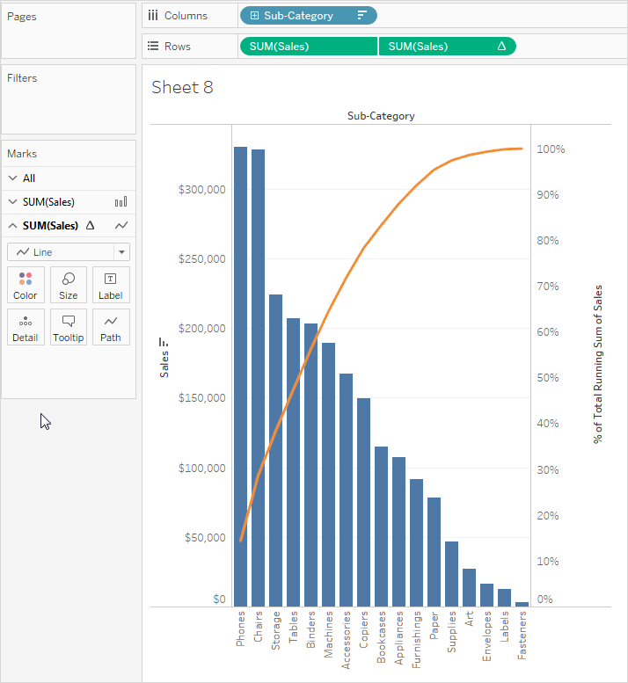
Visualisation of Data Distributions
Visualising data distributions — pareto chart
https://help.tableau.com/current/pro/desktop/en-us/pareto.htm

Slide 27
Forecasting

Slide 28
Forecasting
The general approach
Forecasting is the act of predicting future values based on historical values
Parameters are variables that allow data visualisation users to alter the content of a formula or change a dimension or measure contained in the view
Using parameters, data visualisation users can change normally static values into dynamic entities that facilitate ad-hoc analysis without the need to change the design of the data visualisation

Slide 29
Forecasting
Creating forecasts
Trend and season
Trend only
Season only
No trend or season
Parameters: Reference Line, Bin Size (Histogram), Ranking (in-value comparison)
Please read these two webpages to understand how to perform forecasting in Tableau…
https://help.tableau.com/current/pro/desktop/en-us/forecast_options.htm
https://help.tableau.com/current/pro/desktop/en-us/forecast_how_it_works.htm
Tableau recommends the best forecasting method for the data but note that “predicting” the future is always imprecise. Even simple trend lines have an implied “Ceteris Paribus” (all things being equal) assumption.
Don’t try to suggest/utilize forecasting data unless you are familiar with the methods, especially pros and cons.

Slide 30
Tableau (Class Activity)

Slide 31
Tableau (Class Activity)
Work with your team-mates to create the following visuals:
Map View
Scatterplot with filter
Histogram
Boxplot
Create Parameter
Forecast chart
Use Global Superstore 2016 – Use filter to retrieve only US data
Spend about 10 mins per chart doing this; there are 6 charts above. At the end of each 10 min block, I will pick 1 random team to show us how they did it.
Notes:
When you create map views using the online map provider, Tableau stores the images that make up the map in a cache. That way, as you continue your analysis you don’t have to wait for the maps to be retrieved. In addition, by storing the maps, you can do a certain amount of work when you are offline. For more information, see Select Background Maps.
The cache for the maps are stored with your temporary internet files and can be cleared at any time by deleting the temporary files from your browser.
Stored map images and legends remain valid for about thirty days. After that time, Tableau will not use the stored image; instead, it will require you to reconnect and fetch an updated map. This is to prevent the map images from becoming outdated.
Read more at https://help.tableau.com/current/pro/desktop/en-us/maps.htm

Slide 32
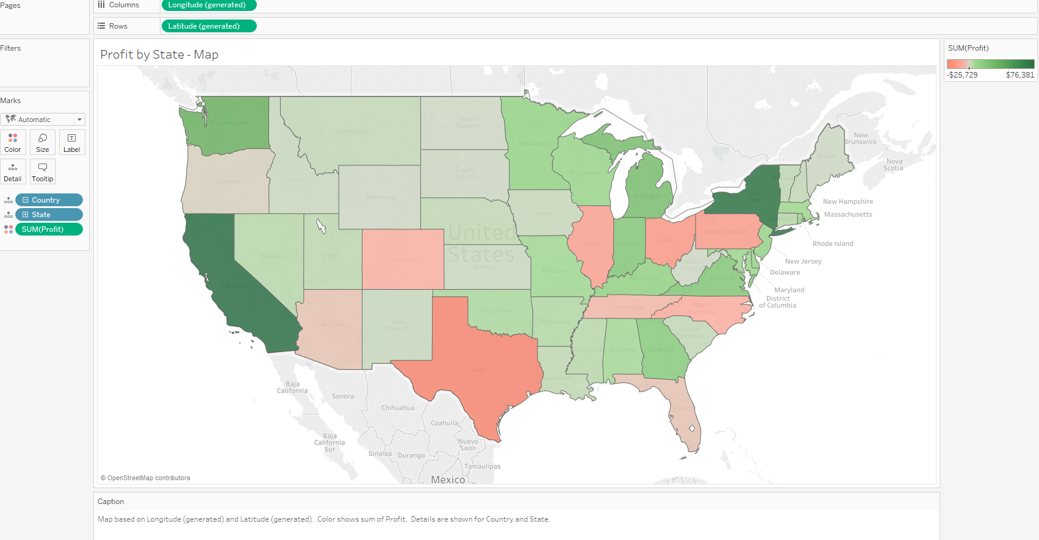
Tableau (Class Activity)
Map View
Notes:
Use Global Superstore 2016 – Order Data, Using filter on country to retrieve only US data
Set Longitude to be columns and Latitude to be rows, country and state to be details and sum(profit) as colour. Note that the map is loaded from openstreet map and required online connectivity. If offline map is required you can store the map. (information provided below). Show students the map layers, note that there is no map layer for offline map. Show students how to change the colour to green-red as shown above. Explain the map view briefly.
Map View Offline - When you create map views using the online map provider, Tableau stores the images that make up the map in a cache. That way, as you continue your analysis you don’t have to wait for the maps to be retrieved. In addition, by storing the maps, you can do a certain amount of work when you are offline. For more information, see Select Background Maps.
The cache for the maps are stored with your temporary internet files and can be cleared at any time by deleting the temporary files from your browser.
Stored map images and legends remain valid for about thirty days. After that time, Tableau will not use the stored image; instead, it will require you to reconnect and fetch an updated map. This is to prevent the map images from becoming outdated. Read more at https://help.tableau.com/current/pro/desktop/en-us/maps.htm

Slide 33
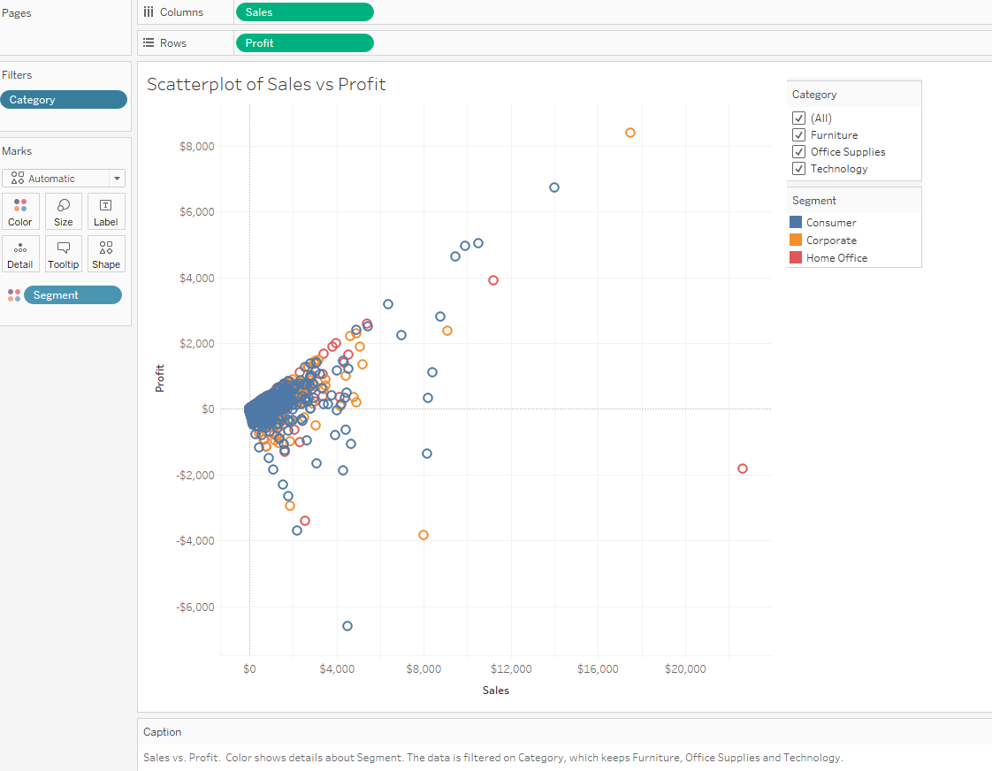
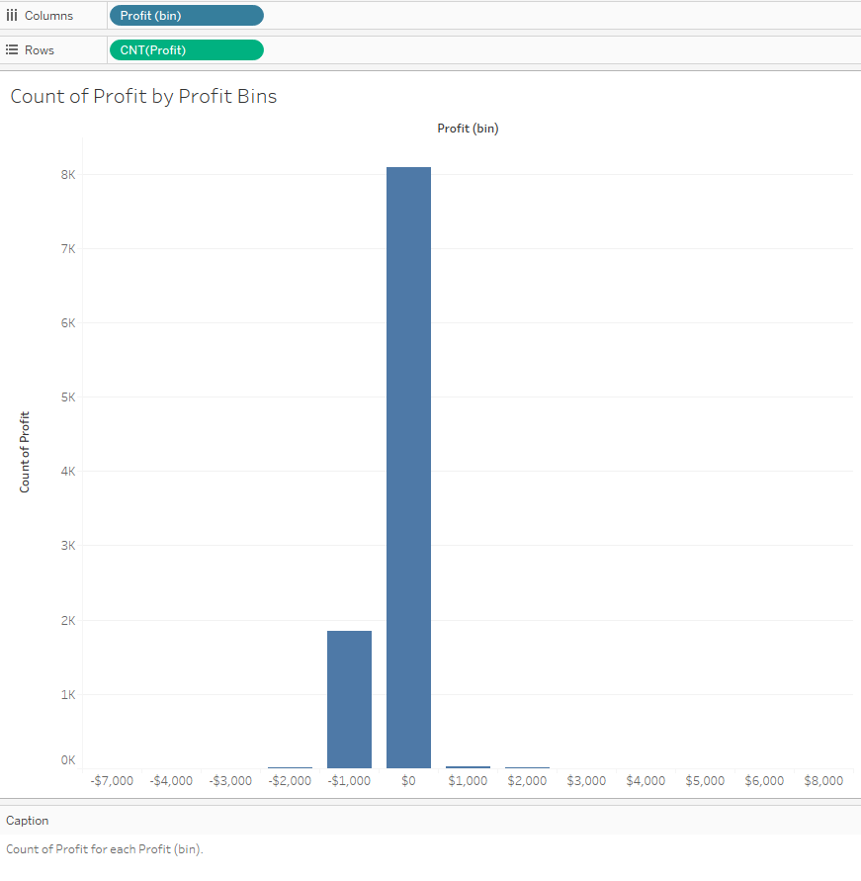
Tableau (Class Activity)
Scatterplot
Histogram
Notes:
2. Scatterplot – Uncheck Aggregate measures and explain why this need to be done. Set sales to be column and profit to be Row. Set colour to be customer segment. Create a filter for product category. Explain the difference between filtering at the chart and filtering at the data sources tab. Explain the chart briefly.
3. Histogram – Go Measures, Right Click on Profit to Create Bins for Profit and set the bin size to 1000. Explain that Tableau can suggest bin size. Set Profit (bin) for column and count(profit) to be row. Explain how to change from sum(profit) to count(profit). Explain the difference between creating bins and groups.

Slide 34
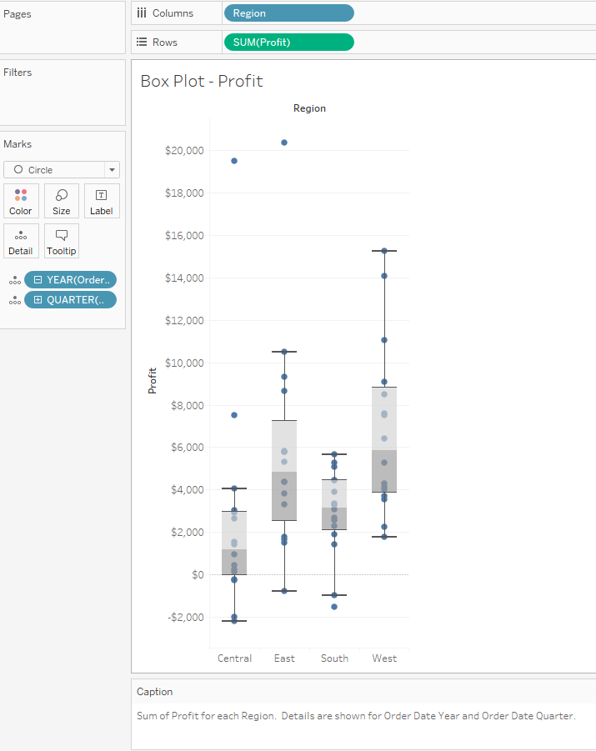
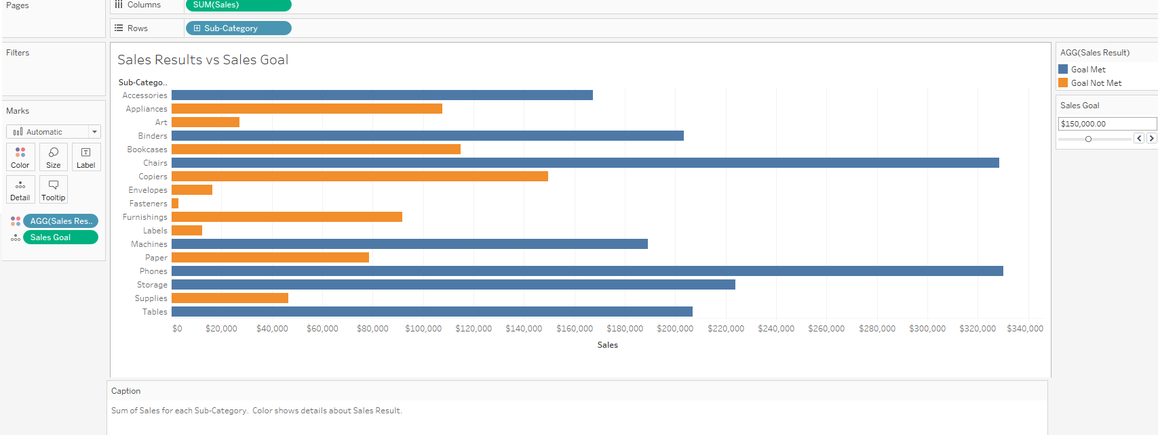
Tableau (Class Activity)
Boxplot
Create Parameter
Notes:
4. Boxplot – Set Region for column and sum(profit) to be row. Set the Year and Quarter of Order Date to be detail. Explain where is median (50th percentile), 25th (Q1) and 75th (Q3) percentile. Explain that the default boxplot created has whiskers that is 1.5 times of IQR with upper whisker = Q3 + (Q3-Q1)*1.5 and lower whisker = Q1 - (Q3-Q1)*1.5. The whiskers can be set to the min and max value of profit in this case. Show the students how. Explain the chart briefly.
5. Create parameters – Create a parameter, Sales Goal using Sales. Set the data type to be integer and format to currency (standard). Specify current value as 100,000, min as 50,000, max as 300,000 and step size as 1000 (Set Range.). Create a calculated field, Sales Results using Sales. Formula: IF SUM([Sales])<=[Sales Goal] THEN "Goal Not Met" ELSE "Goal Met" END
Set sum(sales) to be column and product sub-category as rows, sales results as the colour and sales goal as the detail. Show how the colour changes accordingly when you move the sales goal slider. (Right Click at Sales Goal under Markers and Select “Show Parameter Control”)

Slide 35
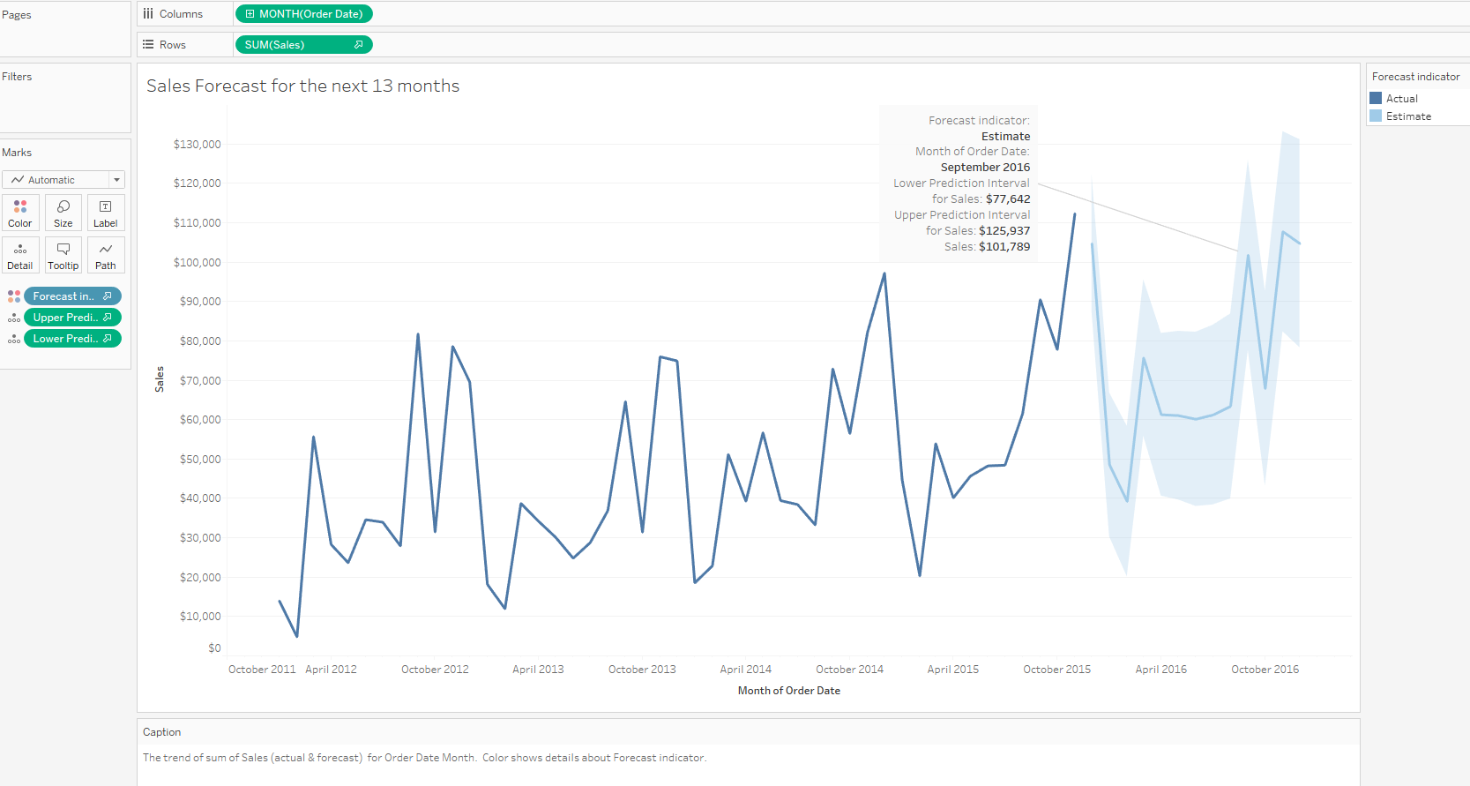
Tableau (Class Activity)
Forecast Chart
Notes:
6. Forecast Chart – Forecast sales. (Need to ensure that sales is a continuous measure). Set month(order date) to be column and sum(sales) as rows. Do a forecast for sales in the next 13 months. Drag Sum( Sales) to Markers, Right Click and select “Forecast Results” then select Upper and Lower Prediction Intervals.
Explain the data requirement for Tableau before it can perform a forecast:
Tableau requires at least five data points in the time series (dates) to estimate a trend, and enough data points for at least two seasons or one season plus five periods to estimate seasonality. For example, at least nine data points are required to estimate a model with a four quarter seasonal cycle (4 + 5), and at least 24 to estimate a model with a twelve month seasonal cycle (2 * 12).
Explain how How Forecasting Works in Tableau
Forecasting in Tableau uses a technique known as exponential smoothing. Forecast algorithms try to find a regular pattern in measures that can be continued into the future.
All forecast algorithms are simple models of a real-world data generating process (DGP). For a high quality forecast, a simple pattern in the DGP must match the pattern described by the model reasonably well. Quality metrics measure how well the model matches the DGP. If the quality is low, the precision measured by the confidence bands is not important because it measures the precision of an inaccurate estimate.
Tableau automatically selects the best of up to eight models, the best being the one that generates the highest quality forecast. The smoothing parameters of each model are optimized before Tableau assesses forecast quality.
When there is not enough data in the visualization, Tableau automatically tries to forecast at a finer temporal granularity, and then aggregates the forecast back to the granularity of the visualization. Tableau provides prediction bands which may be simulated or calculated from a closed form equation. All models with a multiplicative component or with aggregated forecasts have simulated bands, while all other models use the closed form equations.
https://help.tableau.com/current/pro/desktop/en-us/forecast_how_it_works.htm
Show students the options for forecast and explain the options.
Forecast Length
Source Data
Forecast Model
Prediction Interval
https://help.tableau.com/current/pro/desktop/en-us/forecast_options.htm
Show students the describe forecast and explain summary and model. Dun need to go into the math of it.
https://help.tableau.com/current/pro/desktop/en-us/forecast_describe.htm
Add in upper and lower prediction interval for sales under details. Show students how to do annotation to highlight points that they want to bring attention to.

Slide 36
Course Homepage | https://canvas.suss.edu.sg/courses/31564
Study Guide | https://ibookstore.suss.edu.sg/
Tableau Desktop | https://www.tableau.com/products/trial
Tableau Tutorials | https://www.tableau.com/learn/get-started/creator
Academic Calendar | https://www.suss.edu.sg/docs/default-source/contentdoc/oas/pt-2021acadcalendar.pdf

Slide 37
Tableau Desktop System Requirements
Windows
Windows 7 or newer (64 bit)
Intel Pentium 4 or AMD Opteron processor or faster
2 GB memory
1.5 GB minimum free disk space
Mac
iMac/MacBook computers 2009 or newer
macOS High Sierra 10.13 and macOS Mojave 10.14
1.5 GB minimum free disk space
Notes:
Get licenses for students at https://www.tableau.com/academic/teaching/course-licenses

Slide 38
Tableau Prep Builder System Requirements
Windows
Windows 7 or newer (64 bit)
Intel Core i3 or AMD Ryzen 3 Pro or faster
4 GB memory
2 GB minimum free disk space
Mac
macOS High Sierra 10.13 and macOS Mojave 10.14
Intel Core i3 or faster
4 GB memory
2 GB minimum free disk space

